Slide 1


SHANMUGANATHAN ENGINEERING COLLEGE
(Accredited by NAAC, an ISO 9001:2015 Certified Institution)
ARASAMPATTI – 622 507
DEPARTMENT OF ELECTRONICS AND COMMUNICATION ENGINEERING
Deploying a Saas Application on AWS
Presented by,
BALAJI M (912421106003)
BALAKUMAR B (912421106004)
ECE IV YEAR

Slide 2
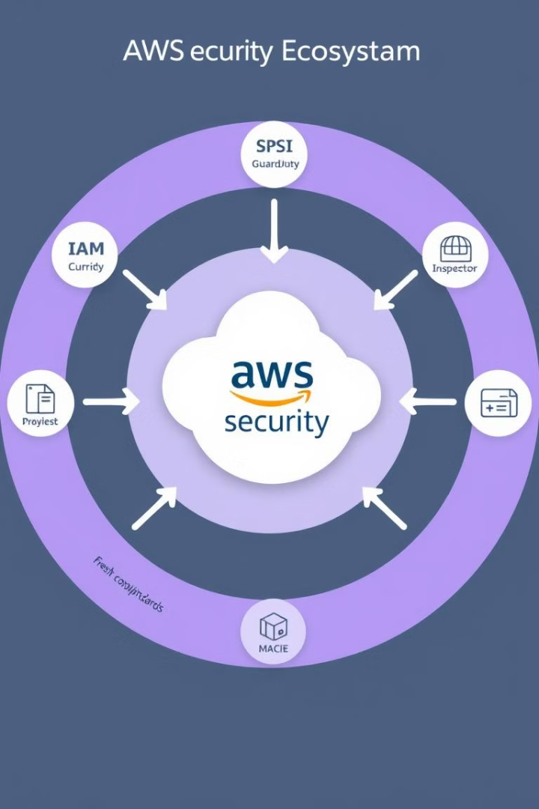
Deploying a SaaS Application on AWS
Discover the power of AWS in hosting your SaaS application, from architectural considerations to scaling and security.
This comprehensive guide will walk you through the process of seamlessly deploying your SaaS on the AWS cloud platform.

Slide 3
Introduction to SaaS and AWS
SaaS Fundamentals
Software as a Service (SaaS) is a software delivery model where applications are hosted and managed remotely, allowing users to access them through the internet.
AWS Capabilities
AWS provides a robust and scalable cloud infrastructure with a wide range of services to support the deployment and management of SaaS applications.
.

Slide 4
Architectural Considerations for SaaS on AWS
Scalability
Design your application to scale up or down based on user demand, utilizing AWS services like Auto Scaling and Elastic Load Balancing.
High Availability
Ensure your SaaS application is highly available by leveraging AWS features like multi-AZ deployments and failover mechanisms.
Data Management
Choose the right AWS data storage solutions, such as Amazon RDS, Amazon DynamoDB, or Amazon S3, based on your application's requirements.

Slide 5
Choosing the Right AWS Services
Compute
Storage
Database
Leverage AWS compute services like Amazon EC2, AWS Lambda, or Amazon ECS to power your SaaS application.
Utilize AWS storage solutions like Amazon S3, Amazon EBS, or Amazon EFS to store and manage your application data.
Choose the appropriate AWS database service, such as Amazon RDS, Amazon DynamoDB, or Amazon Aurora, based on your data requirements.

Slide 6
Setting Up the Infrastructure
Virtual Private Cloud (VPC)
Create a secure and isolated virtual network using Amazon VPC to host your SaaS application resources.
Networking
Configure subnets, routing tables, and security groups to control network access and traffic flow.
AWS Identity and Access Management (IAM)
Establish fine-grained access controls and permissions to manage who can interact with your SaaS application and its resources.

Slide 7
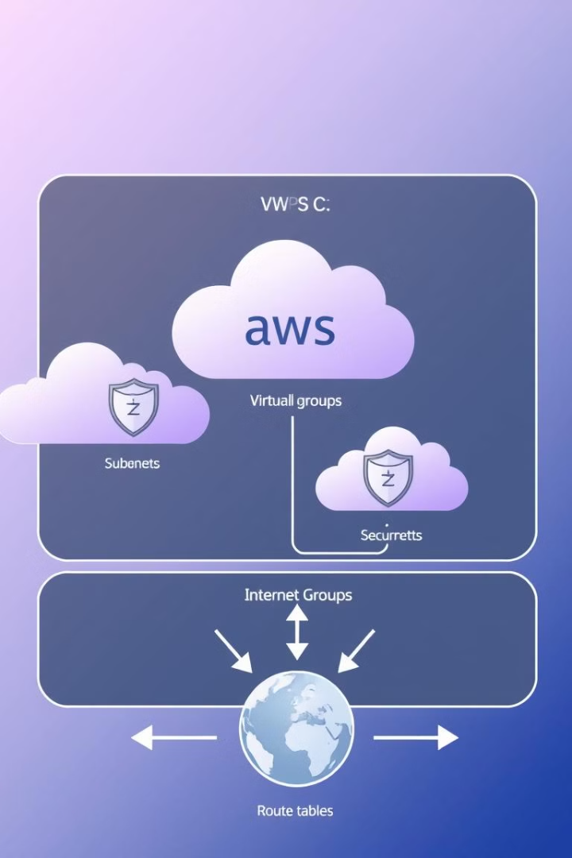
Deploying the Application
Continuous Integration
Automate your build and deployment process using AWS CodePipeline and CodeBuild.
Hosting
Deploy your SaaS application on Amazon EC2 instances or leveraging containerization with Amazon ECS or AWS Fargate.
Database Integration
Integrate your SaaS application with the appropriate AWS database service, such as Amazon RDS or DynamoDB.

Slide 8
Security and Compliance
1
Identity and Access Management
Implement fine-grained access controls using AWS Identity and Access Management (IAM) to secure your SaaS application.
2
Data Encryption
Protect sensitive data by leveraging AWS encryption services, such as Amazon KMS and AWS Certificate Manager.
3
Compliance and Regulations
Ensure your SaaS application meets industry-specific compliance requirements by utilizing AWS services like AWS Config and AWS Security Hub.

Slide 9
Monitoring and Optimization
Performance Monitoring
Utilize AWS CloudWatch to monitor the health and performance of your SaaS application, enabling you to identify and address issues.
Cost Optimization
Leverage AWS Cost Explorer and Trusted Advisor to optimize your cloud spending and ensure efficient resource utilization.
Continuous Improvement
Analyze usage patterns and user feedback to continuously enhance your SaaS application and adapt to changing requirements.

Slide 10
Benefits of SaaS on AWS
Reduced infrastructure costs.
Improved scalability.
Enhanced security are just a few of the advantages of hosting your SaaS on AWS

Slide 11
Conclusion
By leveraging the comprehensive suite of AWS services, you can build, deploy, and scale your SaaS application with ease, while ensuring high availability, security, and cost-effectiveness.

Slide 12


